Slide 1

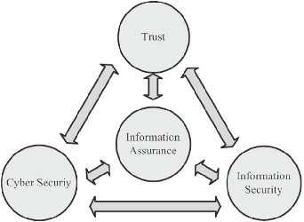
7-2 Final project part 3: Information Assurance
Image Retrieved from: Albuquerque et al., 2016
Christopher Gray
IT-505: Core Technologies
Southern New Hampshire
Dr. Keith Washington
3/16/2023

Slide 2

Information assurance (IA) needs:
Information Assurance is Defined as Security measures that ensure the availability, integrity, authenticity, secrecy, and non-repudiation of information and information systems. These methods include implementing protection, detection, and reaction capabilities to enable the restoration of information systems (csrc.nist.gov, n.d.).
Confidentiality: Information must be kept secret and only authorized personnel should have access to it (Panhalkar, 2019).
Integrity: Data must be safeguarded against unauthorized modification, alteration, or destruction (Panhalkar, 2019).
Availability: When information is needed, it must be available and accessible to authorized users (Panhalkar, 2019).
Authentication: To guarantee that only authorized persons may access information, the identities of those accessing it must be validated (Panhalkar, 2019).
Non-repudiation: The capacity to prevent someone from denying that they did a certain action or made a specific remark (Panhalkar, 2019).
Privacy: Personal information should be protected from unwanted access or use (Panhalkar, 2019).
Compliance: Measures must meet regulatory, legal, and contractual criteria (Goddard, 2021).

Slide 3
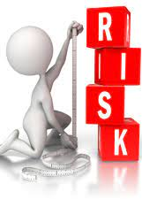
Risks associated with nonadherence to IA processes:
Data Breaches: Failure to adhere to IA protocols might raise the likelihood of data breaches. This can result in the loss of sensitive data such as client information, intellectual property, and financial information. A data breach can have serious implications, including loss of reputation, financial damages, and legal liabilities (Merkulov, 2017).
Lawsuits: A data breach affects not only the compromised corporation, but also its linked workers, clients, customers, partners, and service providers, all of whom may elect to pursue legal action in search of justice and protection. A lawsuit, whether won or lost, can be costly (Merkulov, 2017).
Governmental Audits: Any gross breach of customer data may result in action by the Federal Trade Commission (FTC) on behalf of American consumers. If the organization is determined to be out of compliance and irresponsible, the FTC may not only punish the entity, but also mandate costly yearly compliance audits for the years following the negligent action (Merkulov, 2017).
Damage to Reputation: A security event caused by noncompliance with IA protocols can harm an organization's reputation. This can lead to a loss of client trust, lower revenue, and difficulties in acquiring new customers or partners (Merkulov, 2017).
Image retrieved from: evidence.blogg.lu.se, 2016

Slide 4

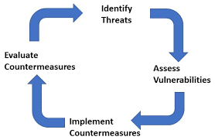
Countermeasures to mitigate risks:
Keep Software up-to-date: verify that all IT software and operating systems are patched with the most recent vendor security and operational fixes (Team, 2019).
Install Anti-Virus Protection Software: Make sure your anti-virus (AV) software is up to date (Team, 2019).
Back-Up Critical Data: Make backup copies of your systems that you can restore in the event of a significant crisis (Team, 2019).
Have employees complete Security training: Ongoing staff education has the biggest influence on data protection and information system security. (Team, 2019).
Secure the infrastructure: Conduct kRisk assessments, Implement security protocols, use multi-factor authentication, firewalls and intrusion detection devices (Team, 2019).
Image Retrieved from: https://security-guidance.service.justice.gov.uk/, n.d.

Slide 5

References
Albuquerque, Robson & García Villalba, Luis & Sandoval Orozco, Ana & de Sousa Junior, Rafael & Kim, Tai-Hoon. (2016). Leveraging information security and computational trust for cybersecurity. The Journal of Supercomputing. online. 1-35. 10.1007/s11227-015-1543-4.
Data Security & Privacy: The Risks of Not Playing by the Rules. (2017). Retrieved 19 March 2023, from https://www.darkreading.com/risk/data-security-privacy-the-risks-of-not-playing-by-the-rules
Editor, C. S. R. C. C. (n.d.). Information assurance (IA) - glossary: CSRC. CSRC Content Editor. Retrieved March 17, 2023, from https://csrc.nist.gov/glossary/term/information_assurance#
Goddard, W. (2021, June 12). The Importance of Information Security Compliance. ITChronicles. Retrieved March 19, 2023, from https://itchronicles.com/information-security/the-importance-of-information-security-compliance/#:~:text=So%2C%20information%20security%20compliance%20means,requirements%20for%20data%20and%20information.

Slide 6
References continued
Graduate course in Risk, Uncertainty and Decision Making. (2016). Retrieved 19 March 2023, from https://evidence.blogg.lu.se/graduate-course-in-risk-uncertainty-and-decision-making/
Panhalkar, T. (2019). Top 5 Key Elements of an Information Security | Infosavvy Security and IT Management Training. Retrieved 19 March 2023, from https://info-savvy.com/top-5-key-elements-of-an-information-security/#:~:text=It%20relies%20on%20five%20major,authenticity%2C%20and%20non%2Drepudiation.
Personnel risk assessment - Security Guidance. (n.d.). Retrieved 19 March 2023, from https://security-guidance.service.justice.gov.uk/personnel-risk-assessment/#personnel-risk-assessment
Team, E. (2019). How to Best Mitigate Cybersecurity Risks and Protect Your Data. Retrieved 19 March 2023, from https://www.atlantic.net/hipaa-compliant-hosting/how-to-best-mitigate-cybersecurity-risks-and-protect-your-data/

